Slide 1
The Hybrid Update Blues
Orchestrating Patches across Servers, VMs, and Clouds

Slide 2
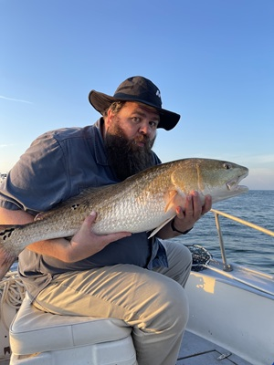



Kristopher Turner
Matthew Wetherell
Minister, Fisherman
IT Infrastructure Manager , USNR
kristopherjturner
in/kristopherjturner
replaceme
in/mtwetherell

Slide 3
The What and Why?
Why do you want to attend this session? Effective patch management is crucial for maintaining robust architectures. Learn strategies to orchestrate updates seamlessly across Azure Local, Hyper-V clusters, standalone servers, Arc-managed machines, and Azure VMs while avoiding disruptions that could jeopardize your environment’s stability. Equip yourself with actionable techniques to coordinate patching in complex hybrid setups.
What will you take away from this session?
Implement effective update strategies for clusters and Azure Local environments.
Explore Arc-enabled update management patterns to enhance patching success.
Master coordinated patching techniques across hybrid infrastructure environments.
Discover best practices to avoid update-induced disruptions in your systems.

